Slide 1




Unmasking Deception: Identifying Fake Reviews using Machine Learning Algorithm
Paper iD-52 Shreya K Department Of Computer Science And Engineering , Sahyadri College Of Engineering & Management, Mangaluru.
Co-Authors:
Sandeep Singh Papola, Yashika Aggarwal, Janvi Gautam, Poonam Daneva1,Rakhee Sharma, Saumya Bansal
CRIIS, Bharati Vidyapeeth Institute of Computer Applications and Management,New Delhi, India

Slide 2
In the vast expanse of e-commerce platforms, user reviews play a pivotal role in shaping consumer decisions . This analysis delves into the critical issue of fake reviews, a consequence of the substantial influence wielded by online feedback for both promotional and demotional purposes. This research aims to enhance trust in e-commerce by comprehensively studying the identification of fake reviews through various supervised machine learning models, offering insights to develop robust systems for a secure online shopping experience.
Abstract

Slide 3

Objectives
Develop and implement a robust fake review detection system leveraging supervised learning techniques.
Improve the trustworthiness and credibility of online reviews by substantially reducing the prevalence of fake feedback instances.

Slide 4
Datasets Used
Yelp website is used for the data sets. It hosts user-generated reviews and recommendations about local businesses, such as restaurants, hotels, and shops etc. Categories of reviews in the dataset: Home and kitchen Sports and outdoor Electronics Movies and tv Tools and home improvement Pet supplies Kindle store Books Toys and games Clothing, shoes and jewelry For training 80% dataset is used and for testing 20% dataset is used.

Slide 5
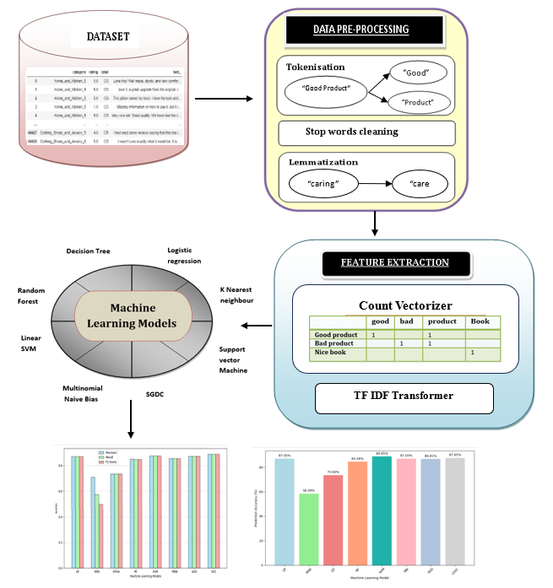
Diagram

Slide 6
Methodology
Data Collection and Preprocessing
Preprocessing Significance:
Essential for ML, eliminating irrelevant and redundant words enhances the accuracy of fake review detection.
Tokenization:
Divides the text into individual words (tokens), facilitating a more granular analysis.
Example: "I love the look and feel of this pillow" becomes tokens: "I", "love", "the", "look", "and", "feel", "of", "this", "pillow".
Stop Words Removal:
Eliminates common, non-contributory words like "and," "this," "is," enhancing the focus on meaningful content.
Example: "I love look feel pillow" after removing stop words.
Lemmatization:
Converts words to their base or dictionary form, ensuring consistency in word representation.
Example: "caring" is lemmatized to "care."

Slide 7
Feature extraction
Count Vectorizer: Converts the bag of words matrix into a table where each row is a review, and each column is a unique word. The numbers in the table show how many times each word appears in each review.
TF-IDF transformer: It converts the bag of words matrix into TF IDF values. These values combine to give the importance of the word in the text. The higher the TF IDF value, the higher the importance of the word in the text.

Slide 8
Algorithms
Logistic regression
K-nearest neighbours
Decision tree classification
Random forest classification
Support vector machines
Multinomial naive bayes
Linear SVC
SGDC (Stochastic Gradient Descent Classifier )

Slide 9
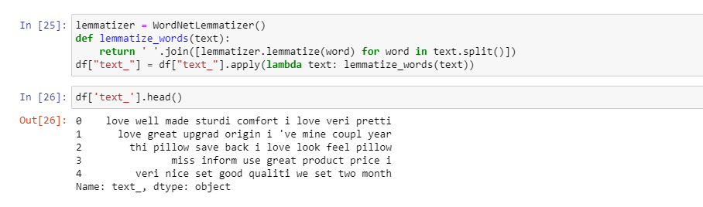
Screenshot – 1:Base Form

Slide 10
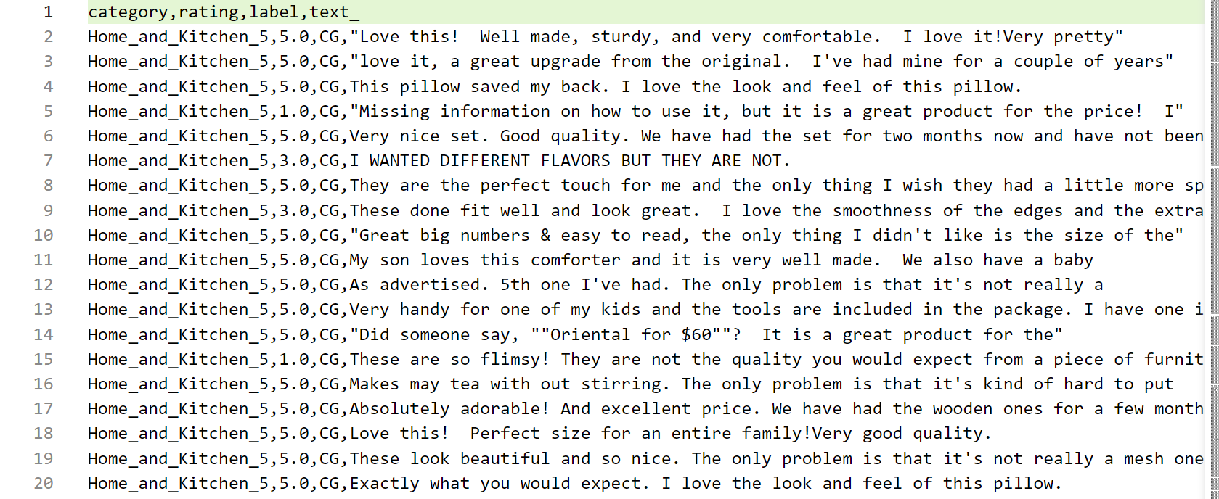
Screenshot - 2:Before Cleaning of Dataset

Slide 11
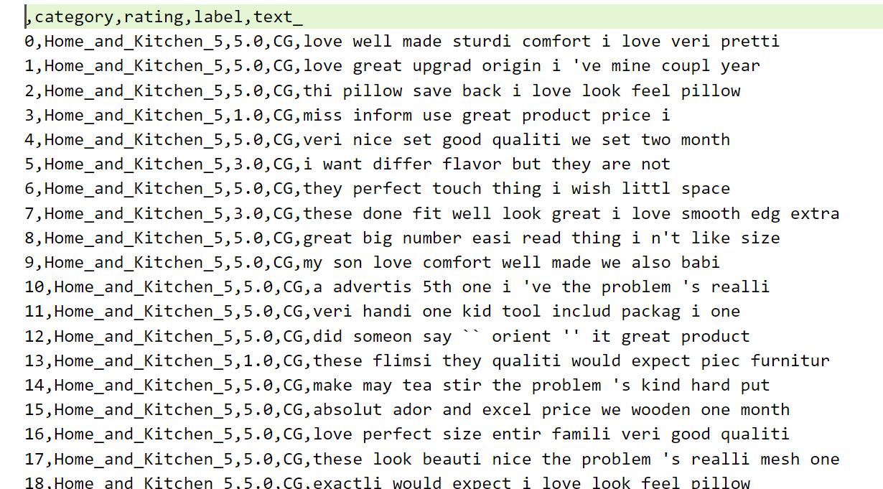
Screenshot - 3: After Cleaning of Dataset

Slide 12
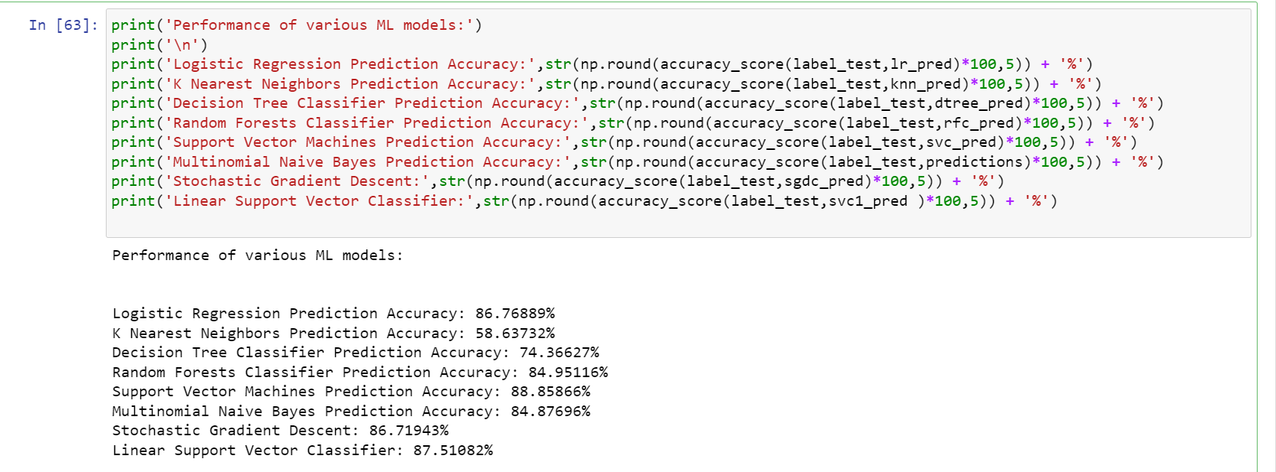
Screenshot - 5: Result

Slide 13

Result and Discussion
In this work, precision, recall, and F1-score are used to evaluate various classifiers.
i. Precision: It is the ratio of the correctly identified fake reviews (True Positive) to the total number of reviews that are predicted as fake.
ii. Recall: It is the ratio of the correctly identified fake reviews to the total number of actual fake reviews.
iii. F1-score: It is the harmonic mean of precision and recall.

Slide 14
Classifiers | TP | FP | TN | FN
LR | 3572 | 576 | 3468 | 471
kNN | 790 | 104 | 3940 | 3253
DT | 2943 | 1035 | 3009 | 1100
RF | 3262 | 468 | 3576 | 781
SVM | 3651 | 510 | 3534 | 392
MNB | 3572 | 576 | 3468 | 471
Linear SVC | 3527 | 483 | 3561 | 516
SDGC | 3590 | 614 | 3430 | 453
Table 4. Comparative analysis of various ML models
Classifiers | Precision | Recall | F1- Score | Accuracy
LR | 0.87 | 0.87 | 0.87 | 0.87
kNN | 0.72 | 0.58 | 0.51 | 0.57
DT | 0.74 | 0.74 | 0.74 | 0.73
RF | 0.85 | 0.85 | 0.85 | 0.84
SVM | 0.89 | 0.89 | 0.89 | 0.88
NB | 0.87 | 0.87 | 0.87 | 0.87
Linear SVC | 0.88 | 0.88 | 0.88 | 0.87
SDGC | 0.87 | 0.87 | 0.87 | 0.86

Slide 15
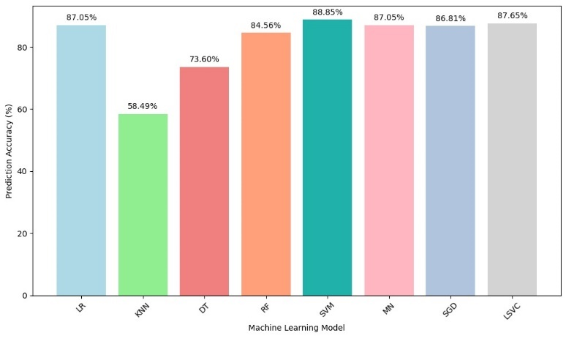
Screenshot - 6: Result
It can be observed that SVM outperforms other models with a precision of 0.89 followed by LSVC and LR with a precision of 0.87. DT and kNN classifiers have the found to be worst-performing models with a precision of 0.72 and therefore should not be considered to identify fake reviews.

Slide 16

Conclusion
Fake review detection is crucial for maintaining the integrity of online business systems and protecting consumers from misleading information. Through the utilization of advanced technologies and methodologies, such as machine learning and natural language processing, it is possible to develop automated systems that can effectively identify and flag fake reviews. It benefits consumers, businesses, and online platforms by enabling informed decisions, protecting reputations, and fostering trust. Based on the experimental evaluation both linear SVC and support vector machines with precision 0.88 and 0.89 respectively demonstrated strong performance in detecting fake reviews.

Slide 17
References
1.Ott, M., Cardie, C., Hancock, J.: Estimating the prevalence of deception in online review communities. In: Proceedings of the 21st international conference on World Wide Web. pp. 201–210. Association for Computing Machinery, New York, NY, USA (2012).
2.Mohawesh, R., Xu, S., Tran, S.N., Ollington, R., Springer, M., Jararweh, Y., Maqsood, S.: Fake Reviews Detection: A Survey. IEEE Access. 9, 65771–65802 (2021)..
3.Choi, Y., Farnadi, G., Babaki, B., Broeck, G.V. den: Learning Fair Naive Bayes Classifiers by Discovering and Eliminating Discrimination Patterns. Proceedings of the AAAI Conference on Artificial Intelligence. 34, 10077–10084 (2020).
4.Birim, Ş.Ö., Kazancoglu, I., Kumar Mangla, S., Kahraman, A., Kumar, S., Kazancoglu, Y.: Detecting fake reviews through topic modelling. Journal of Business Research. 149, 884–900 (2022).
5.Poonguzhali, R., Sowmiya, S.F., Surendar, P., Vasikaran, M.: Fake Reviews Detection using Support Vector Machine. In: 2022 International Conference on Sustainable Computing and Data Communication Systems (ICSCDS). pp. 1509–1512 (2022).

Slide 18
6.Melleng, A., Jurek-Loughrey, A., P, D.: Sentiment and Emotion Based Representations for Fake Reviews Detection. In: Proceedings of the International Conference on Recent Advances in Natural Language Processing (RANLP 2019). pp. 750–757. INCOMA Ltd., Varna, Bulgaria (2019).
7.Elmurngi, E., Gherbi, A.: Fake Reviews Detection on Movie Reviews through Sentiment Analysis Using Supervised Learning Techniques. Presented at the (2018).
8.Mir, A.Q., Khan, F.Y., Chishti, M.A.: Online Fake Review Detection Using Supervised Machine Learning And BERT Model, http://arxiv.org/abs/2301.03225, (2023).
9.Mukherjee, A., Venkataraman, V., Liu, B., Glance, N.: Fake Review Detection: Classification and Analysis of Real and Pseudo Reviews.
10.Rout, J.K., Dash, A.K., Ray, N.K.: A Framework for Fake Review Detection: Issues and Challenges. In: 2018 International Conference on Information Technology (ICIT). pp. 7–10 (2018).

Slide 19
Thank You

